Slide 1

kulturehire
Vinay Patel
Career Aspiration of GenZ
Presented by Vinay Patel (Data Analyst)

Slide 2
Table of Content
Introduction
Objective
Problem Statement
Scope
Tools and Technologies
Key Findings
Key Wow Insight
Dashboard
Recommendations
Takeaways
Kulturehire
Vinay Patel

Slide 3
Vinay Patel
Introduction
Born between 1997 and 2012, Gen Z is the youngest generation in the workforce
Known for their digital fluency, social consciousness, and desire for meaningful work.
Gen Z will make up a significant portion of the global workforce in the coming years.
Understanding their career preferences helps businesses attract, engage, and retain top talent.
Their unique perspectives will influence future workplace trends and company culture.
Career Aspiration of GenZ
01
kulturehie

Slide 4
Vinay Patel
Objective
Career Aspiration of GenZ
Analyze career aspirations, work preferences, education abroad, salary expectations of GenZ
Identify key factors influencing their career choices, including education, work environment, and salary expectations.
Understand how Gen Z aligns their professional goals with personal values like social impact and work-life balance.
02
Kulturehire

Slide 5
Vinay Patel
Problem Statement
Career Aspiration of GenZ
Organizations struggle to align traditional career paths with Gen Z’s evolving preferences.
Gen Z is seeking purpose-driven careers, yet companies often lack clarity on how to provide these opportunities.
There is a disconnect between what Gen Z values (flexibility, work-life balance, social impact) and what many companies offer.
Understanding these career aspirations is critical for businesses to attract, engage, and retain this new generation of talent.
03
Kulturehire

Slide 6
Vinay Patel
Scope
Career Aspiration of GenZ
Focuses on Gen Z individuals (born 1997–2012) who are entering or are in the early stages of their careers.
Career aspirations and long-term goals.
Salary expectations and growth over the first 5 years.
Importance of company values, social impact, and mission alignment.
Interest in pursuing education abroad and sponsorship opportunities.
04
Kulturehire

Slide 7
05
01
05
5W1H
Excel Dashboard
02
06
Google Forms
Microsoft Word
03
07
Microsoft Excel
Chat GPT
04
08
Tools And Technologies
My SQL
Github
Kulturehire
-
Career Aspiration of GenZ
-
Vinay Patel

Slide 8
01.
Purpose Over Pay: Gen Z prioritizes meaningful work, choosing employers whose missions align with their personal values over high-paying jobs without purpose.
Key Findings
Flexibility is Non-Negotiable: Flexible work environments, particularly remote and hybrid options, are essential for attracting and retaining Gen Z talent.
02.
06
Fast-Tracked Career Growth: Gen Z has high expectations for rapid professional development and significant salary increases within the first few years of their career.
03.

Slide 9
Key WOW Insight
Purpose is the New Currency: Gen Z overwhelmingly values purpose-driven work over traditional financial incentives. They seek roles where they can contribute to social impact and align with companies that reflect their personal values. This shift marks a transformation in workforce priorities, making purpose a powerful tool for companies to differentiate themselves and attract top Gen Z talent.
Kulturehire
Career Aspiration of Genz
Vinay Patel
07

Slide 10
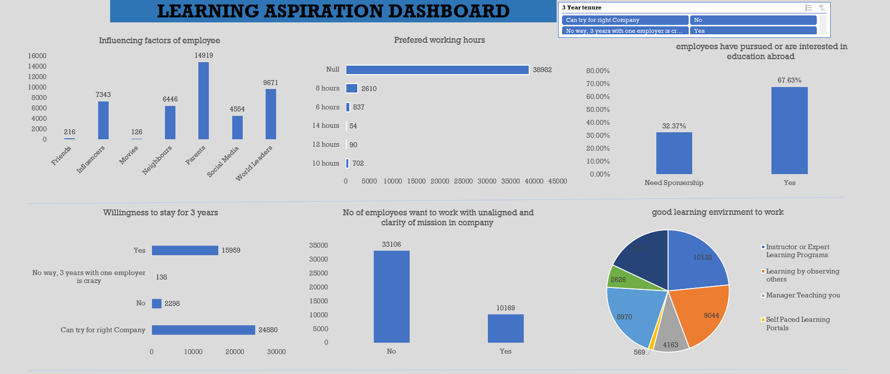
Learning Aspiration Dashboard

Slide 11
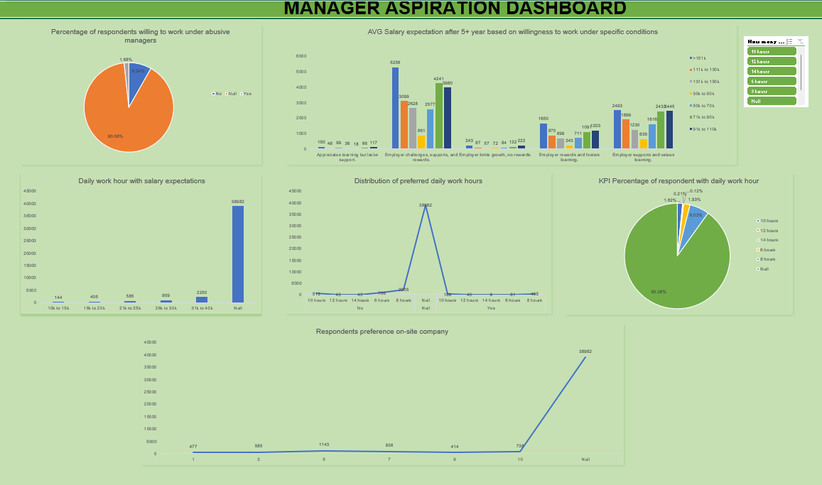
Manager Aspiration Dashboard

Slide 12
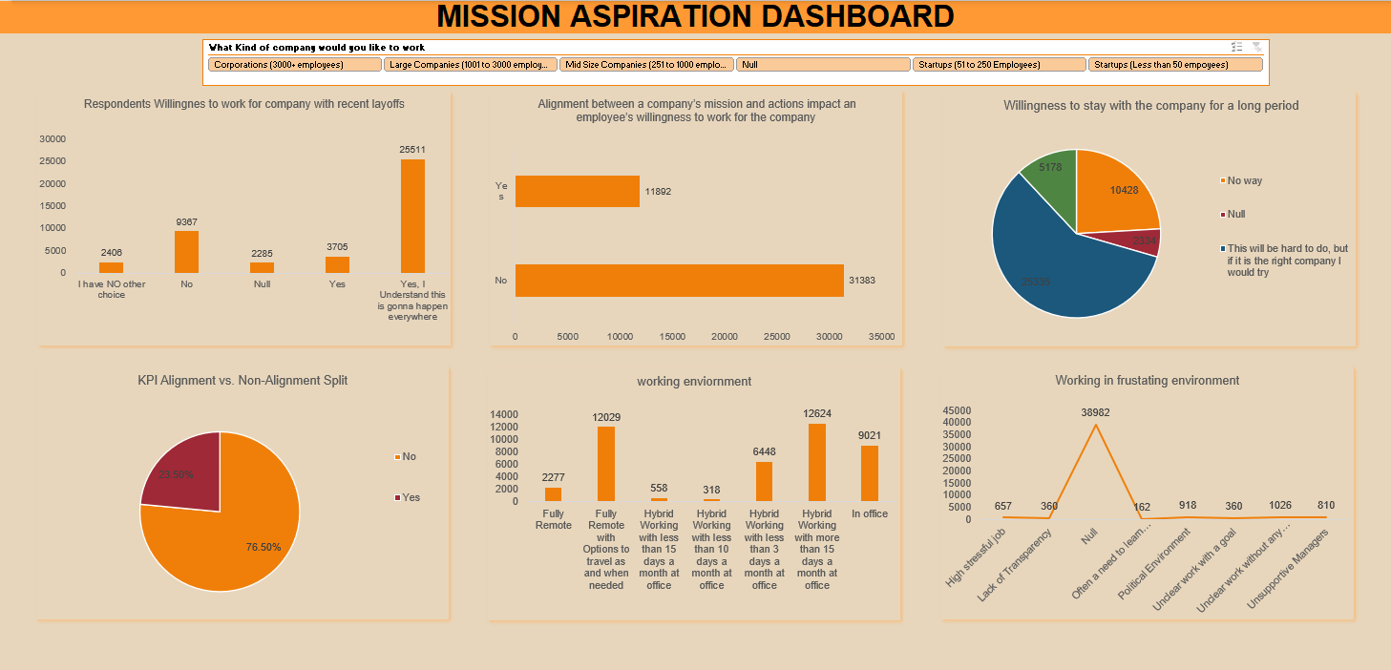
Mission Aspiration Dashboard

Slide 13
09
Recommendations
Vinay Patel
Align Mission with Action
Offer Flexibility
Ensure your company’s mission and values are clearly communicated and reflected in everyday business practices to attract purpose-driven Gen Z talent.
Create flexible working environments, including remote and hybrid options, to meet Gen Z’s work-life balance expectations.
Kulturehire
Promote Social Impact
Support Continuous Learning
Highlight and expand on your company’s contributions to social good and sustainability to resonate with Gen Z’s values.
Offer opportunities for further education, including sponsorships for higher learning or international programs, to retain ambitious talent.
Career Aspiration of GenZ

Slide 14


01
04
Learning Opportunities
Purpose Matters
Socially Conscious Workforce
02
Flexibility is Crucial
Takeaways
05
Fast Career Growth
07
03
06
Mental Health & Well-Being

Slide 15
Kulturehire
-
Career Aspiration of GenZ
-
Vinay Patel
Thank You
Vinay Patel
vinaypatel0039@gmail.com

